Slide 1



Predicting Higher-Dimensional Geometric Features From Lower-Dimensional Representation Using Deep Neural Networks
Sayan Patra
Mentor – Hassan Nadeem
Advisor – Dr. Diwakar Shukla
01/06/2024 – 31/07/2024

Slide 2
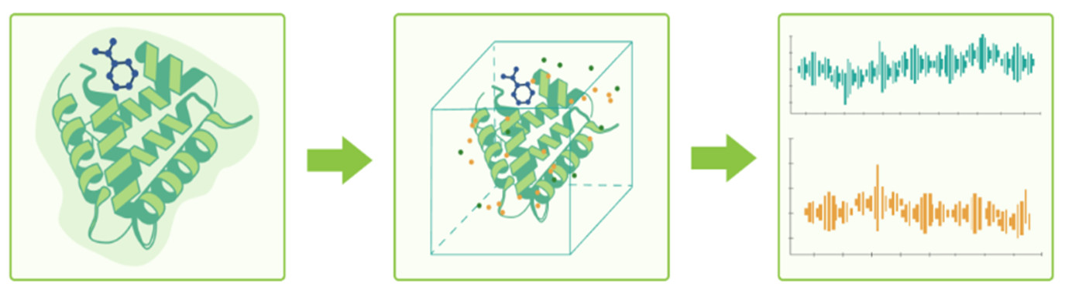

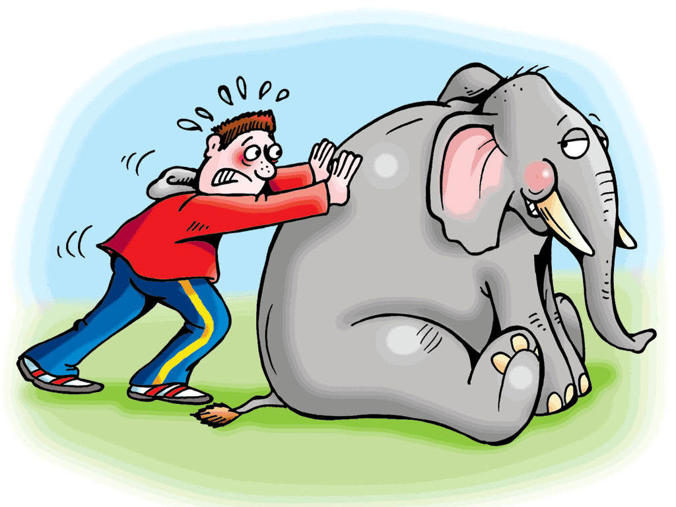
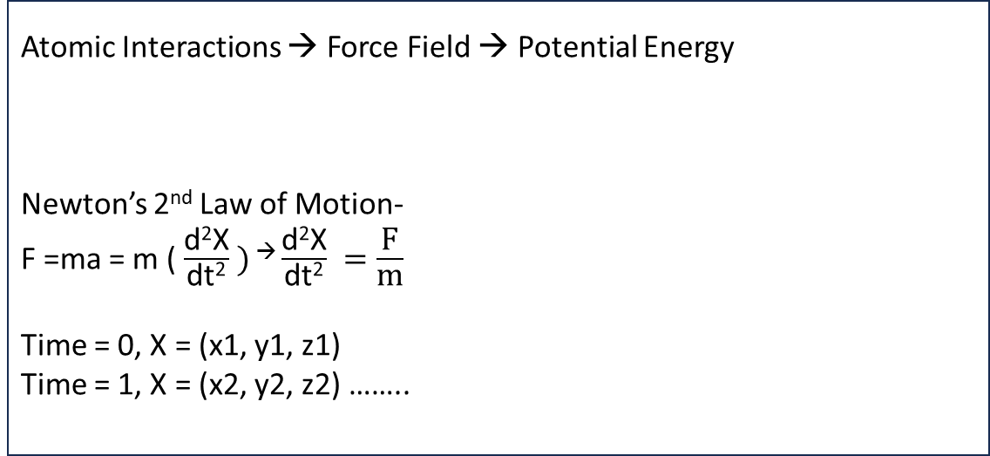
MOLECULAR DYNAMICS SIMULATION
Protein → Amino acids
A lot of atoms
Huge set of data
Atomic Interactions → Force Field → Potential Energy
Newton’s 2nd Law of Motion-
F =ma = m ( $\frac{\text{d}\text{2}\text{X}}{\text{dt}\text{2}} )$ → $\frac{\text{d}\text{2}\text{X}}{\text{dt}\text{2}} =\frac{\text{F}}{\text{m}}$
Time = 0, X = (x1, y1, z1)
Time = 1, X = (x2, y2, z2) ……..
F = Force
m = Mass
a = acceleration
X = position
t = time
Number of atoms = N
System dimensions = 3N (X, Y, Z)
t number of time steps = 3N * t = 3Nt

Slide 3
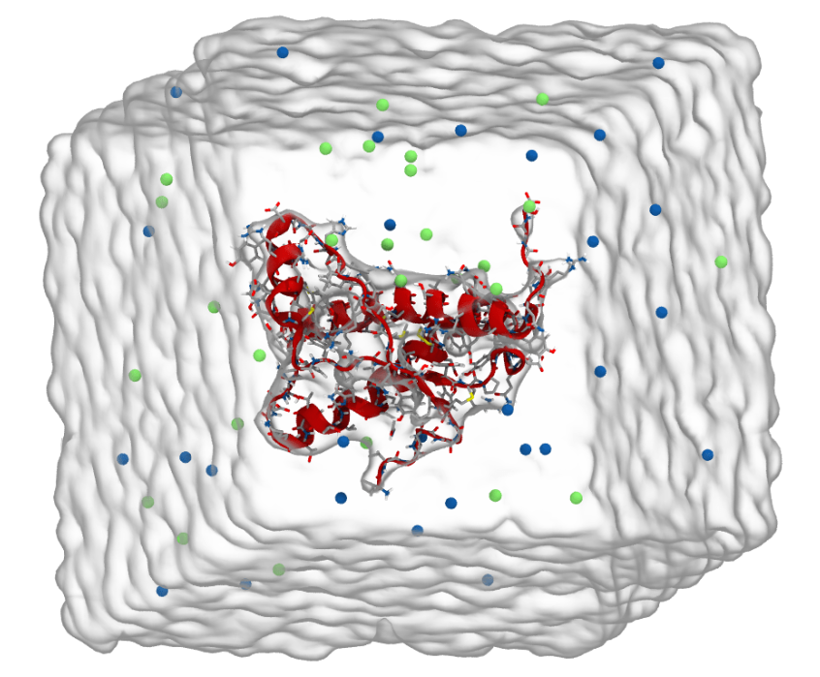
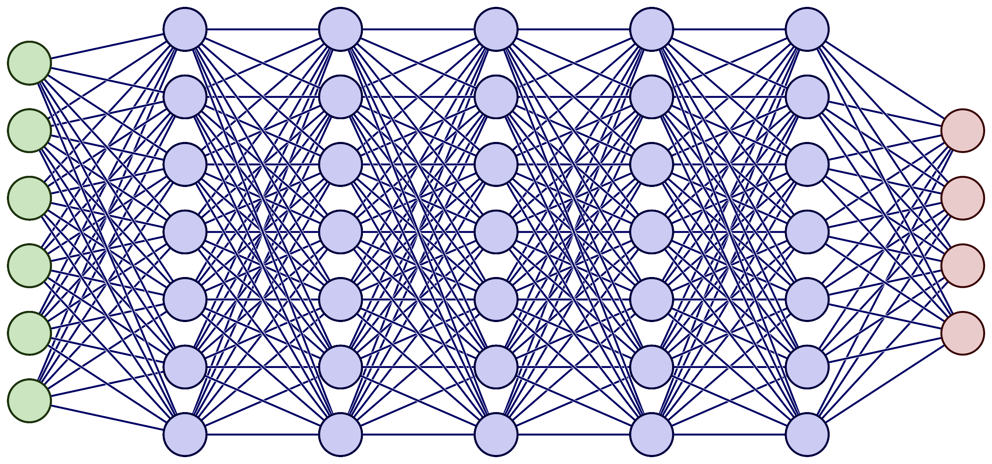
From high-dim to low-dim, and vice versa
As MD simulations are high-dimensional, various dimensionality reduction methods exist, e.g. (tICA, time-lagged independent component analysis)
These methods allow for analysis and understanding of the underlying properties of the system
But can we go back to the high-dim space?
Can we use ML algorithms to recover the lost information to derive the original features from the simulation?
Heavy atoms (C, N, O, S)
Geometric Featurization
Res1 – Res2 Dis
Res2 – Res3 Dis
Res3 – Res1 Dis
Multilayer Perceptron
Convolutional Neural Network
Generative Adversarial Networks
Transformer Architecture
Kinetic Featurization
tic 1
tic 2
tic 3

Slide 4
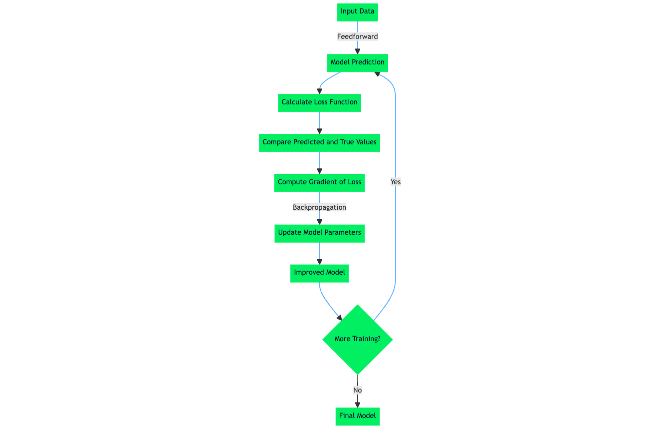
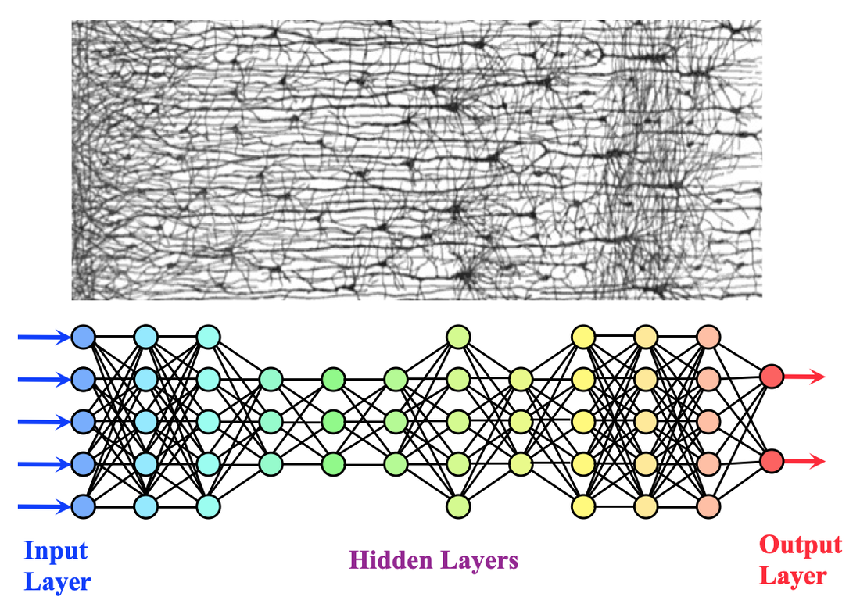
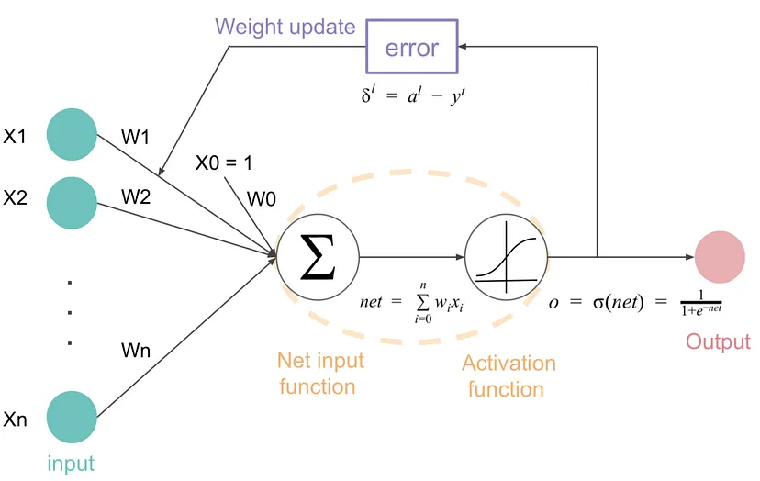
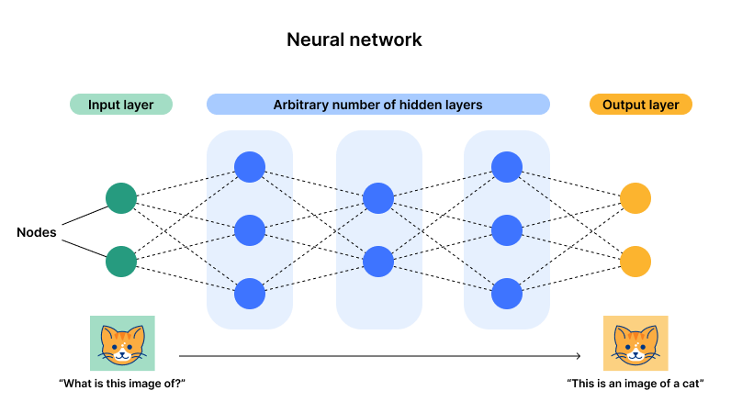
Neural Network

Slide 5
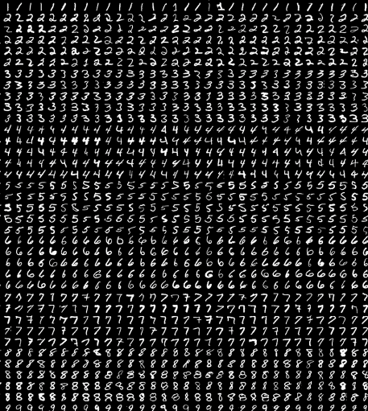
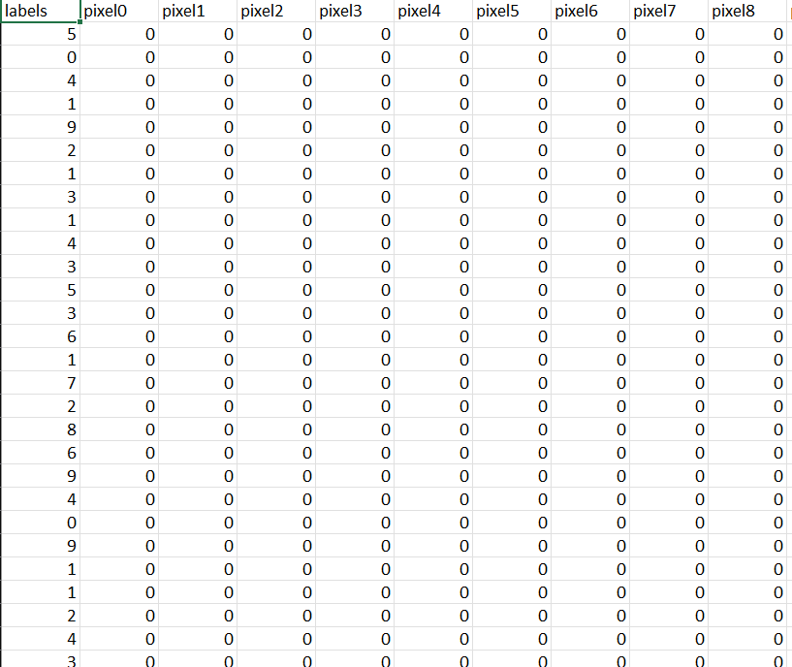
MNIST DATA
28 x 28 pixels
60000 train data
10000 test data
https://www.kaggle.com/datasets/oddrationale/mnist-in-csv
https://www.kaggle.com/code/justuser/mnist-with-pytorch-fully-connected-network/notebook

Slide 6
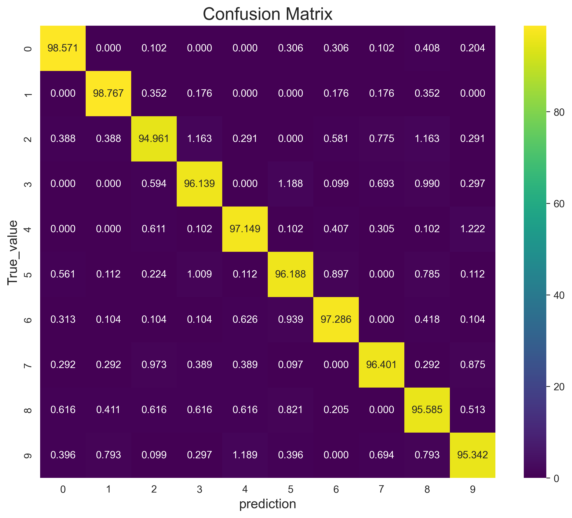
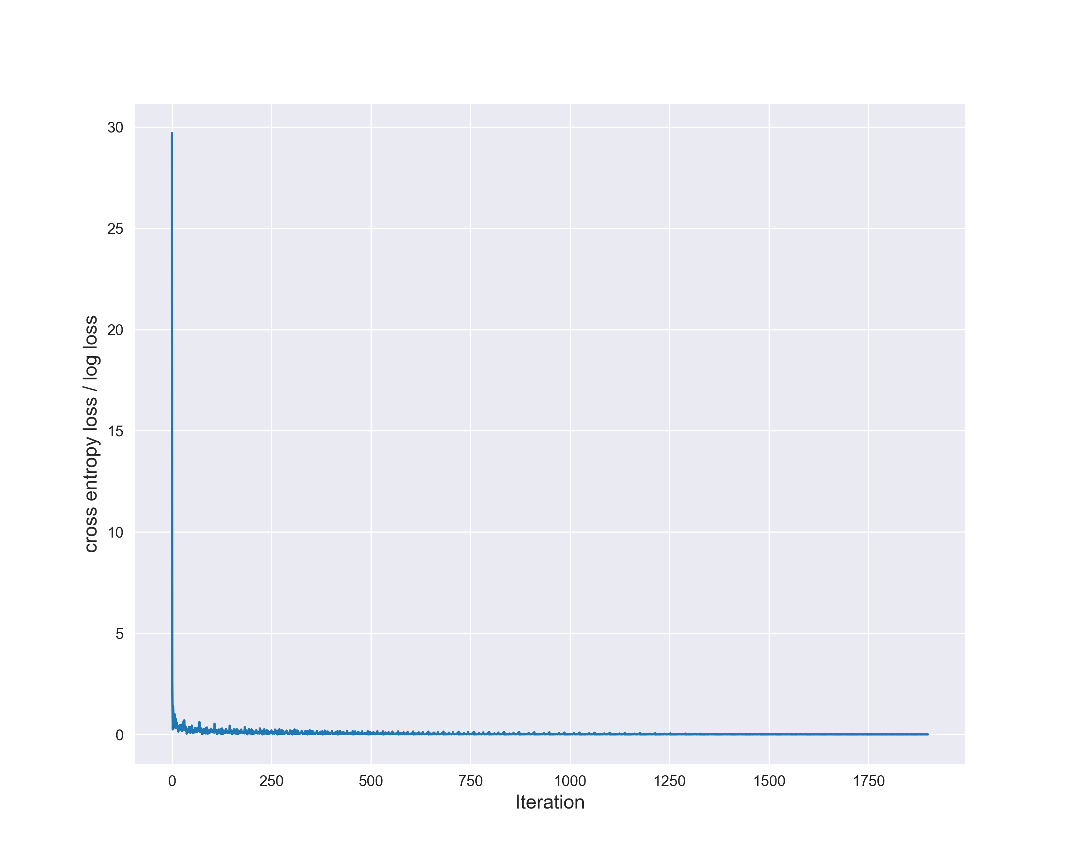
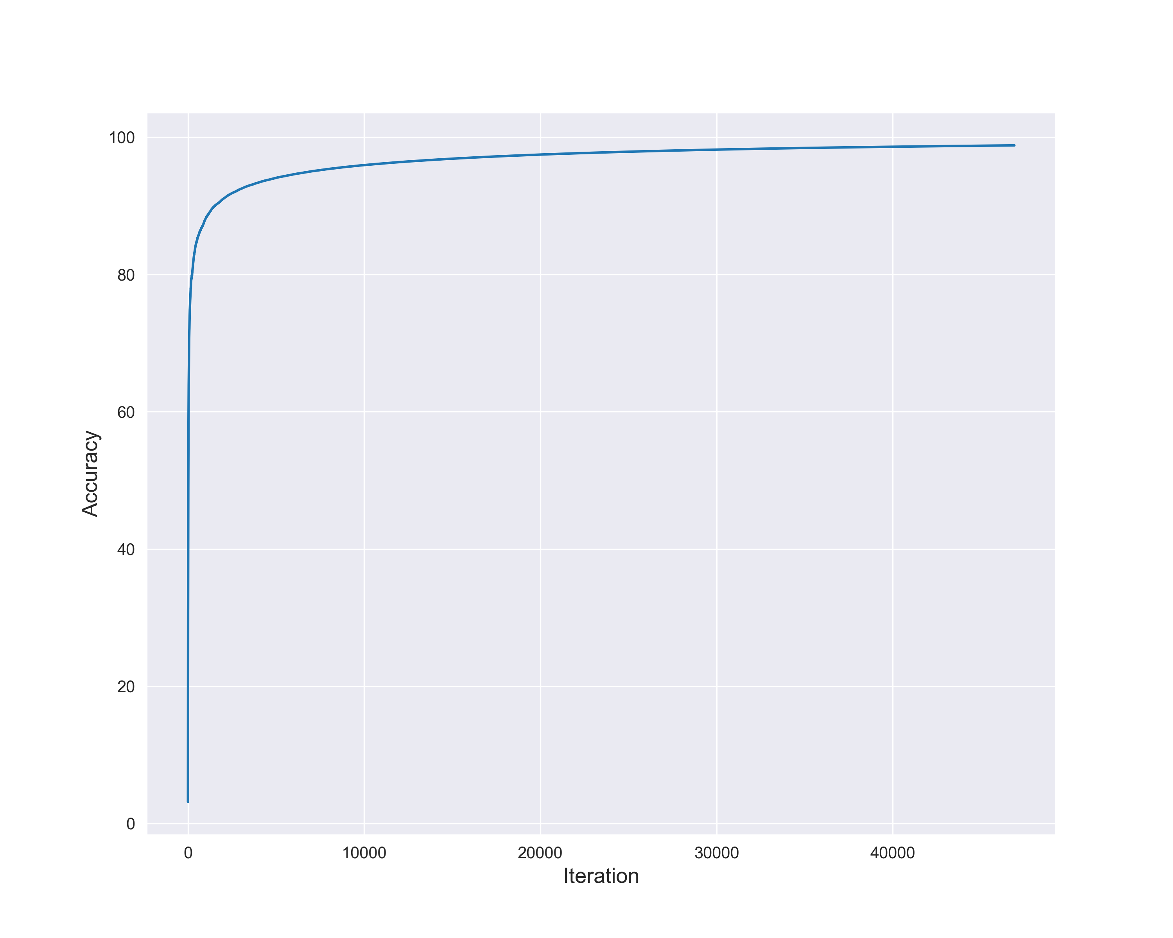
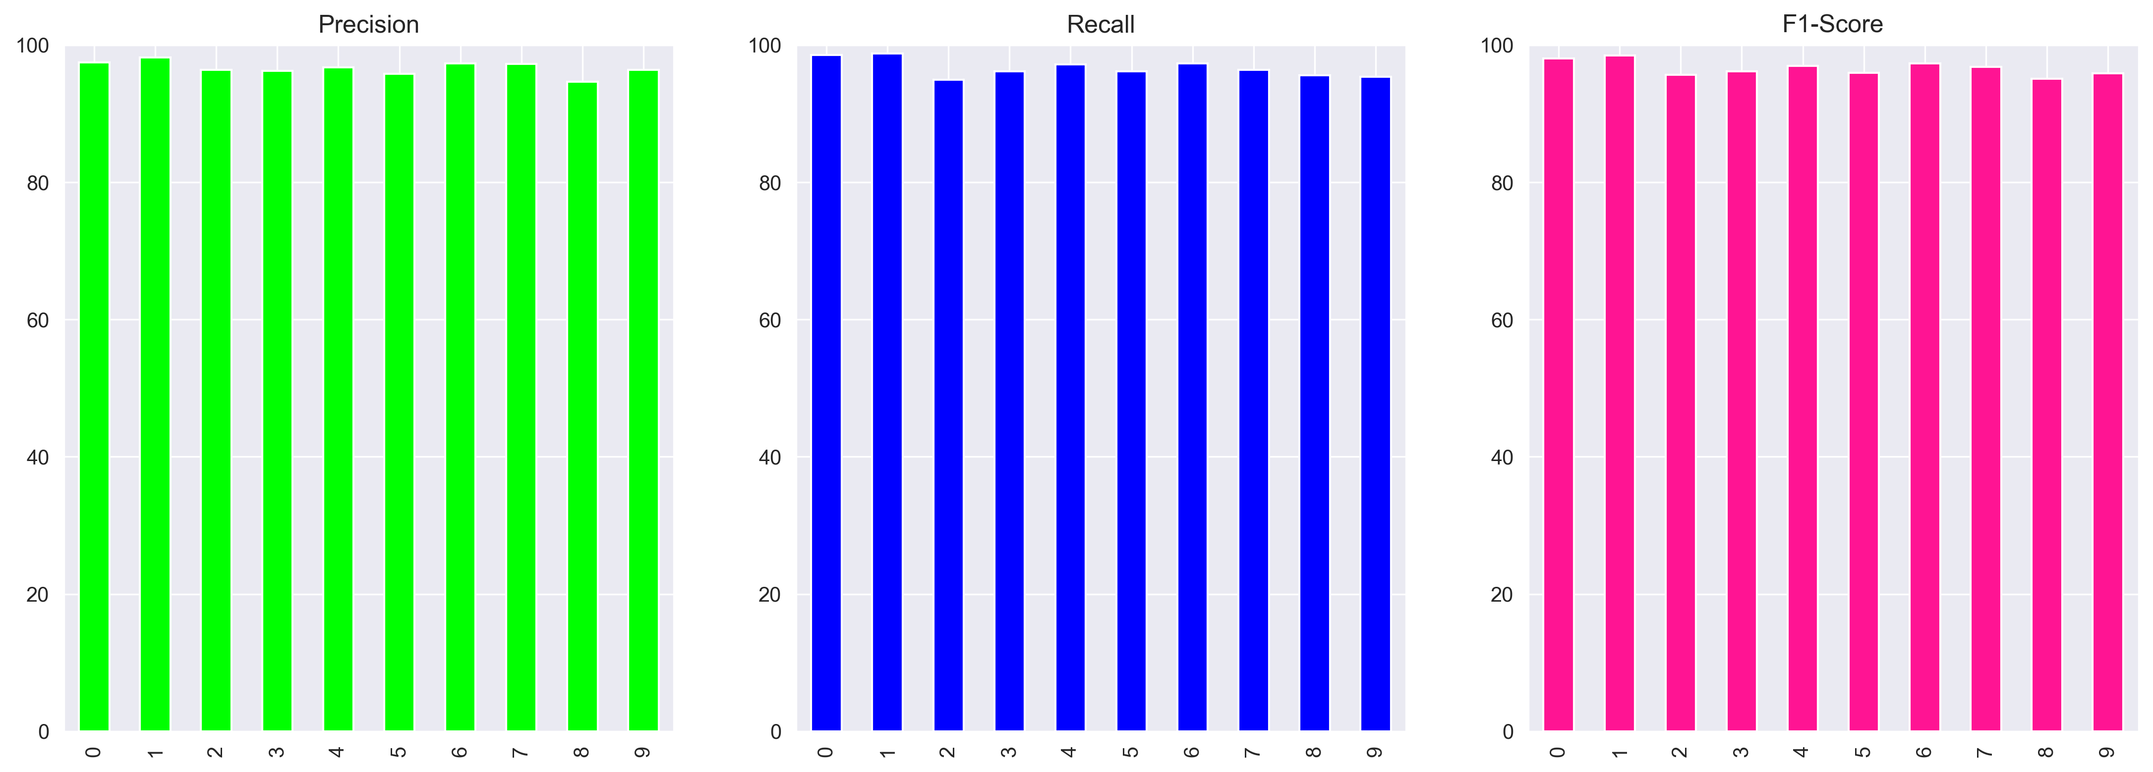
Training of a Machine Learning Model to Classify MNIST Data Using PyTorch
Final Accuracy of Training set = 98.80 %
Accuracy of Classifying test data = 96.60 %

Slide 7
Workflow to Predict Atom Coordinates in Simulation
Using DeepTime performed tICA
Building a Neural Network using PyTorch ( MLP, CNN, etc.)
Selection of a Model Peptide
Coordinate data extraction from the trajectory files using MDTRAJ
Transformed five test frame and predicted frame into PDB file
Calculated the MSE of the Prediction
Fed the Neural Network with Test Data to evaluate the Prediction
Trained the Neural Network with the Train Data and Label Data
Using psfgen converted into psf/PDB files according to CHARMM format
Trained the Neural Network with the Train Data and Label Data
Built a Custom Loss Function
Using OpenMM minimization was performed to remove clashes and unphysical interaction
Data Interpretation

Slide 8
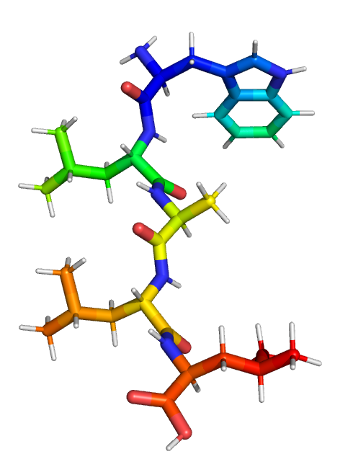
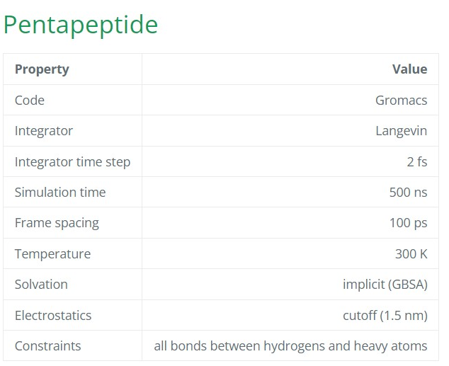
Selection of Model Peptide
Pentapeptide (Trp1, Leu2, Ala3, Leu4, Leu5) from mdshare was used as model system.
Simulation Time of The Pentapeptide – 500 ns x 25.
Used 500 ns x 5 for training and test data
https://markovmodel.github.io/mdshare/pentapeptide/#peptide

Slide 9
Data Preparation
Used 5 x 500ns Trajectory files to extract the atoms coordinates of the pentapeptide to make label for Neural Network
The distances of heavy atoms (all atoms except hydrogen) was extracted and performed tICA to get tICS values as our input data
Using Python’s Scikit learn the input data and label was divided into 60 : 20 : 20 as Train, Validation and Test set

Slide 10
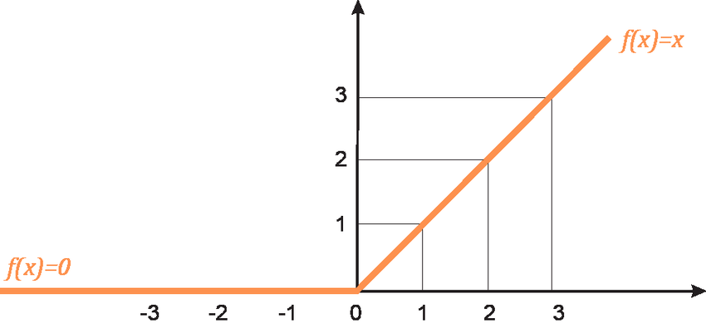
Building The Neural Network
ReLU
Input Layer
First Hidden Layer
ReLU activation
Dropout
Second Hidden Layer
ReLU activation
Dropout
Optimizer - Adam (Adaptive Moment Estimation) with learning rate = 0.001
Third Hidden Layer
Loss Function - MSE (Mean Square Loss)
Sigmoid activation
Output Layer

Slide 11
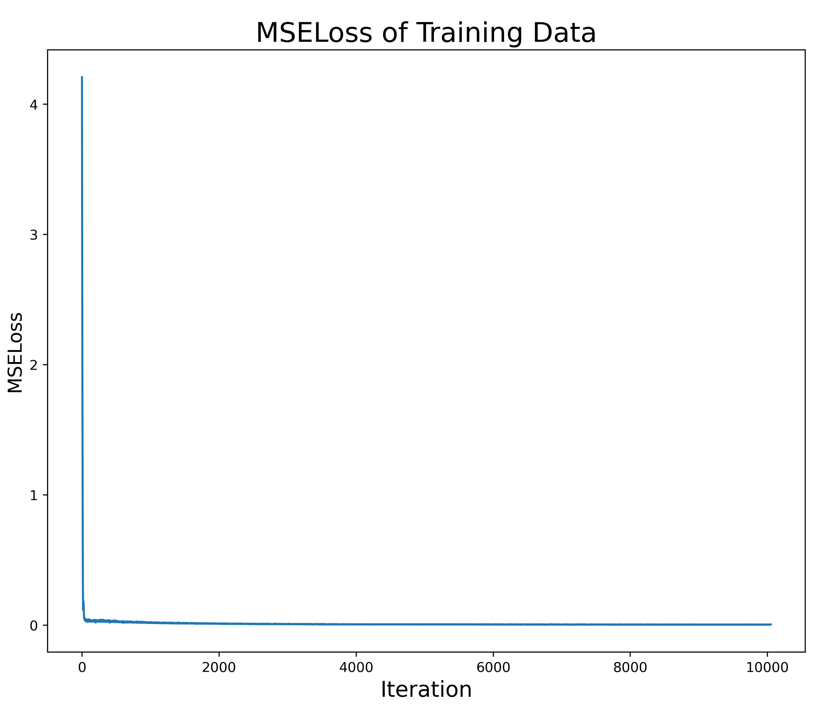
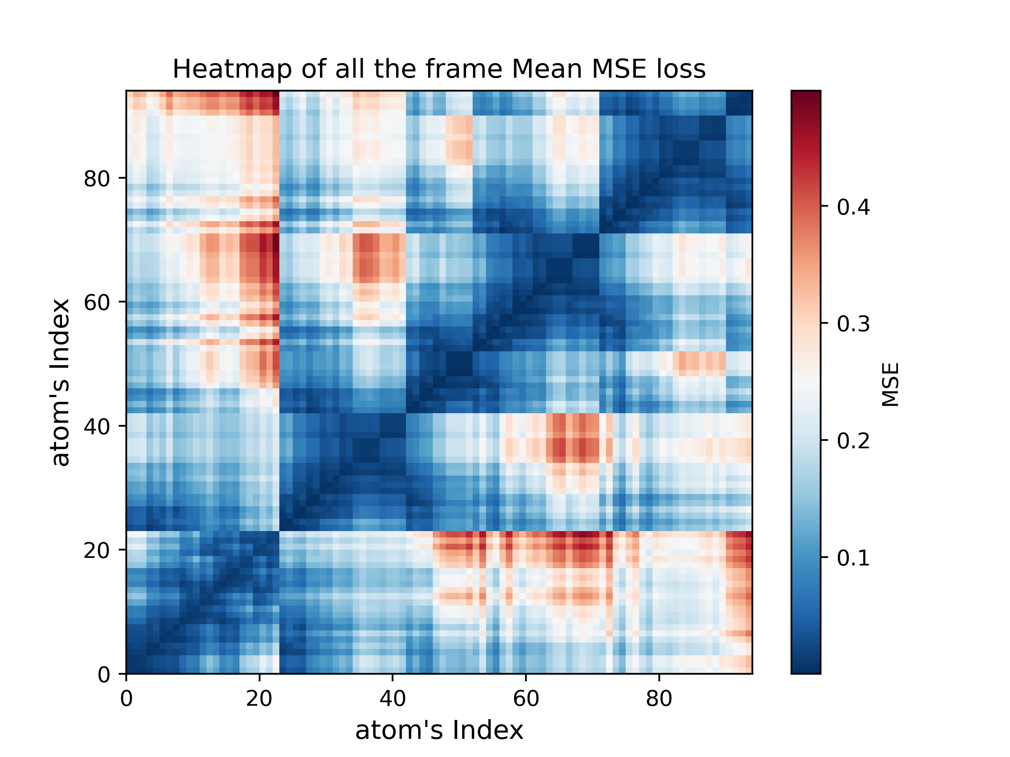
Outputs of Neural Network
MSE loss of Training Data
MSE loss of each atoms coordinate for all the frame

Slide 12
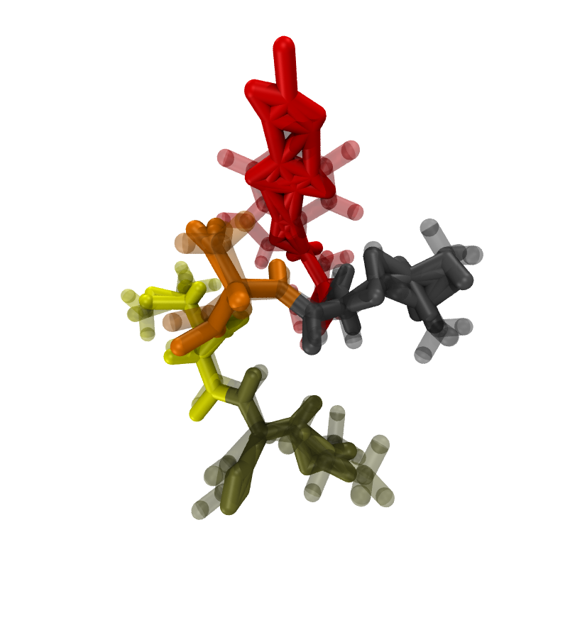
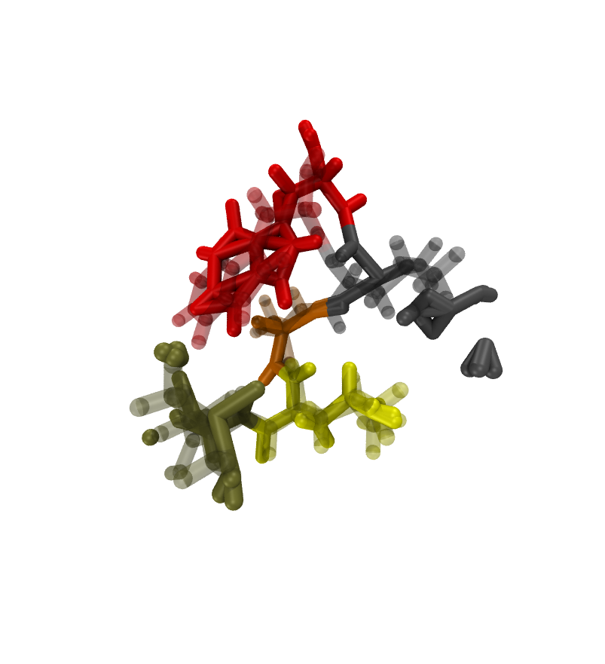
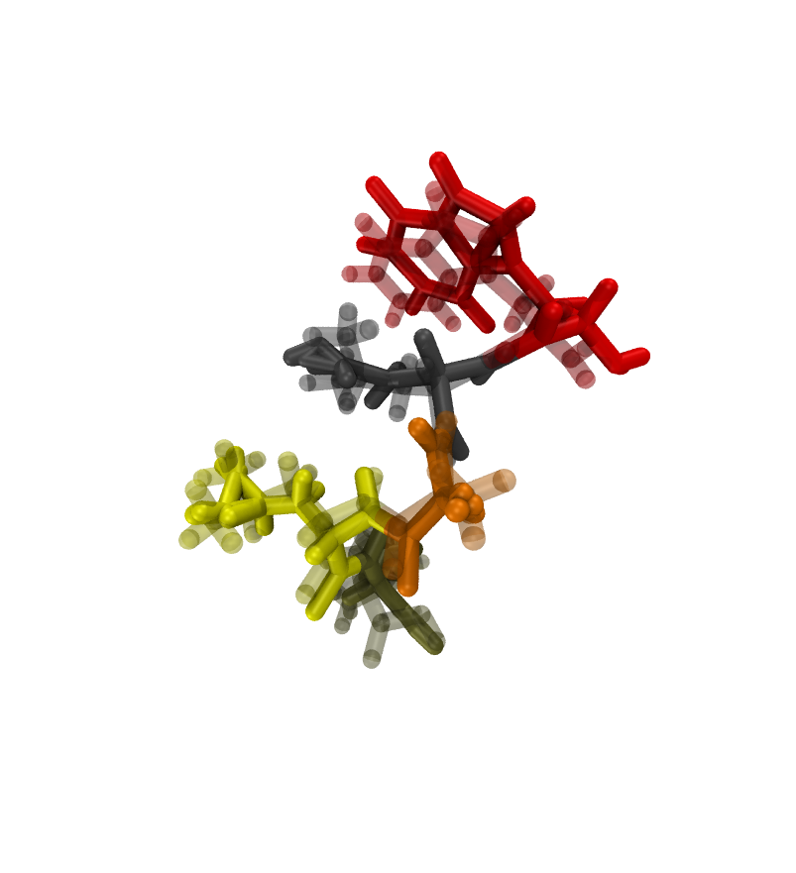
Predictions(solid) with labels (transparent) before minimization

Slide 13
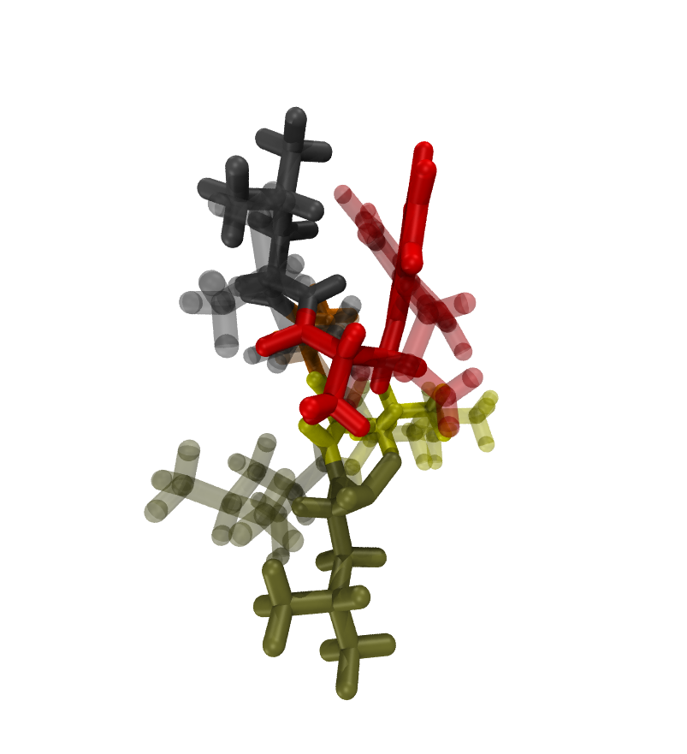
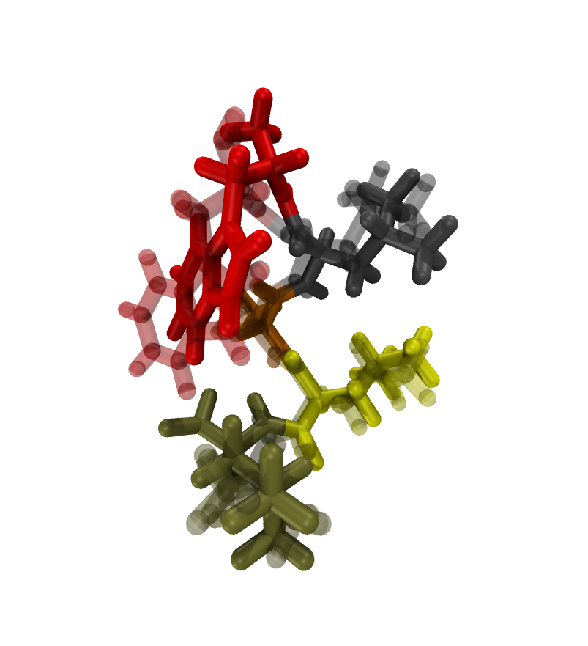
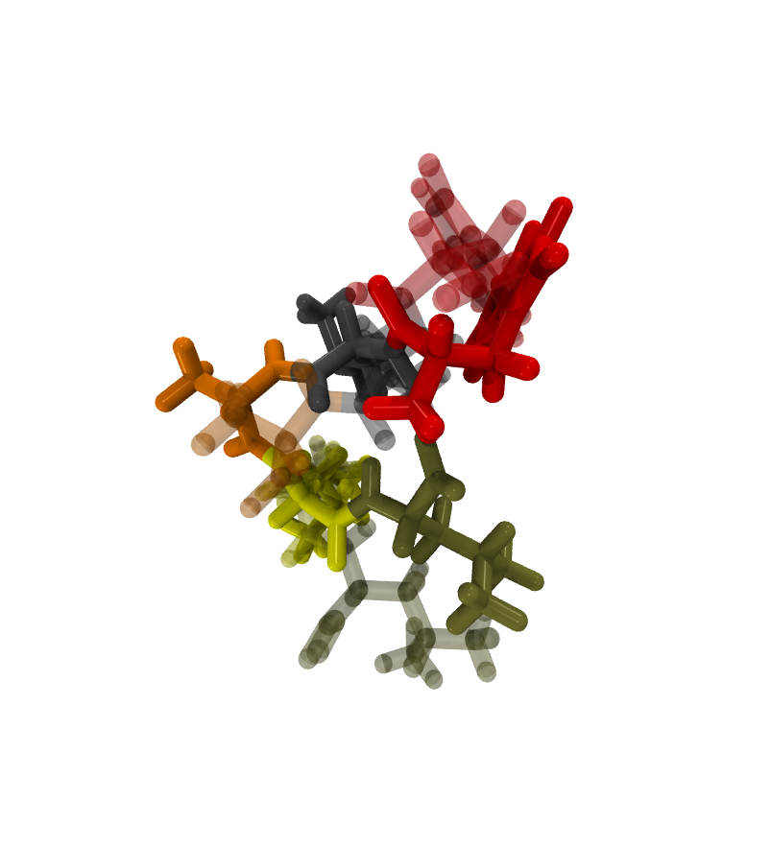
Predictions(solid) with labels (transparent) after minimization

Slide 14
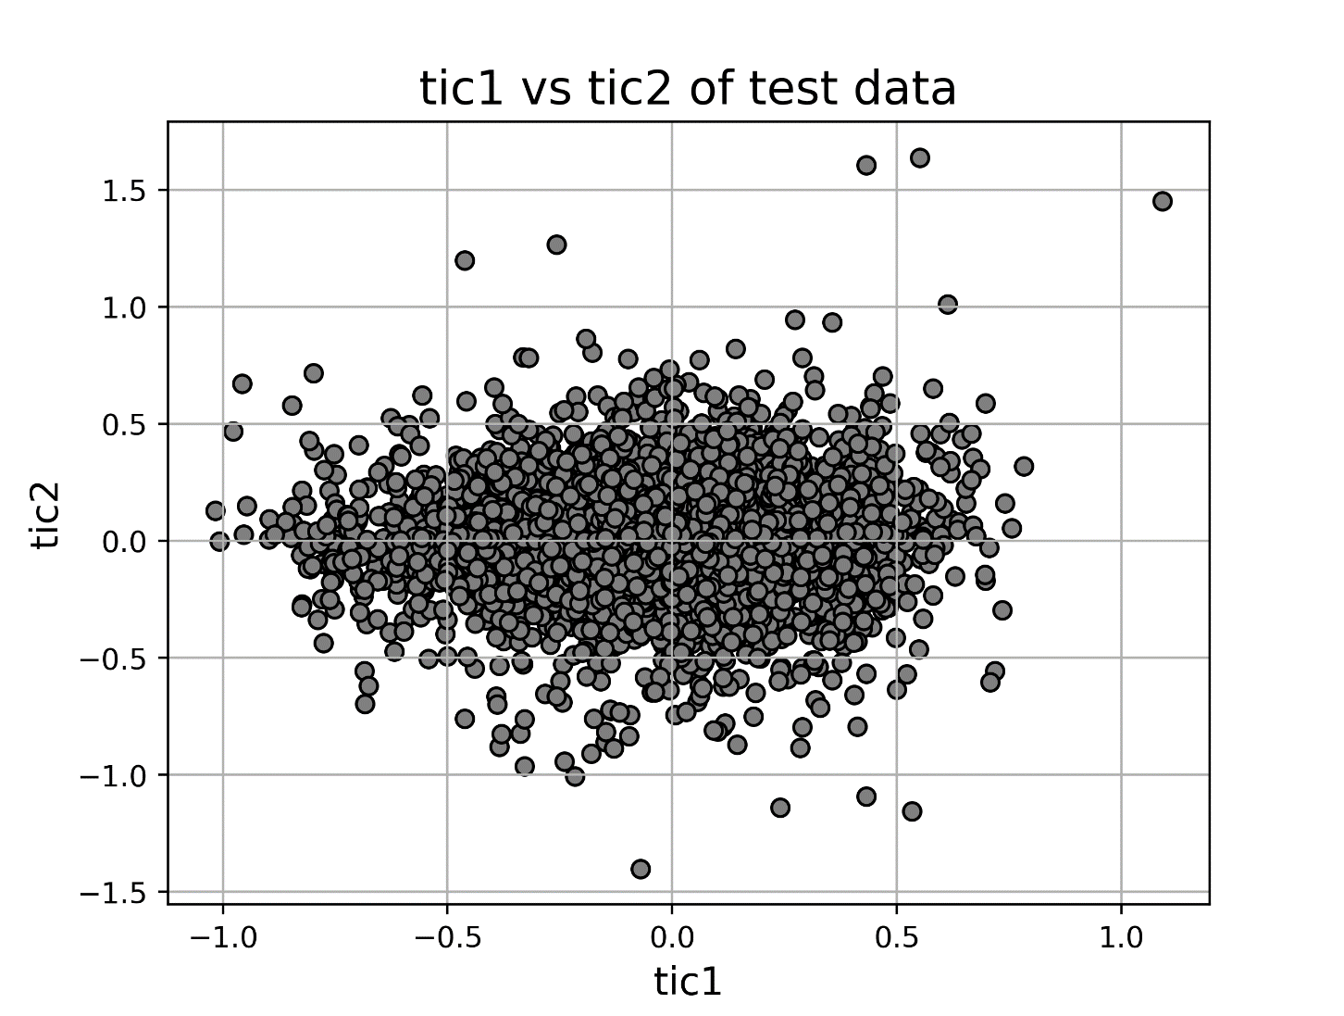
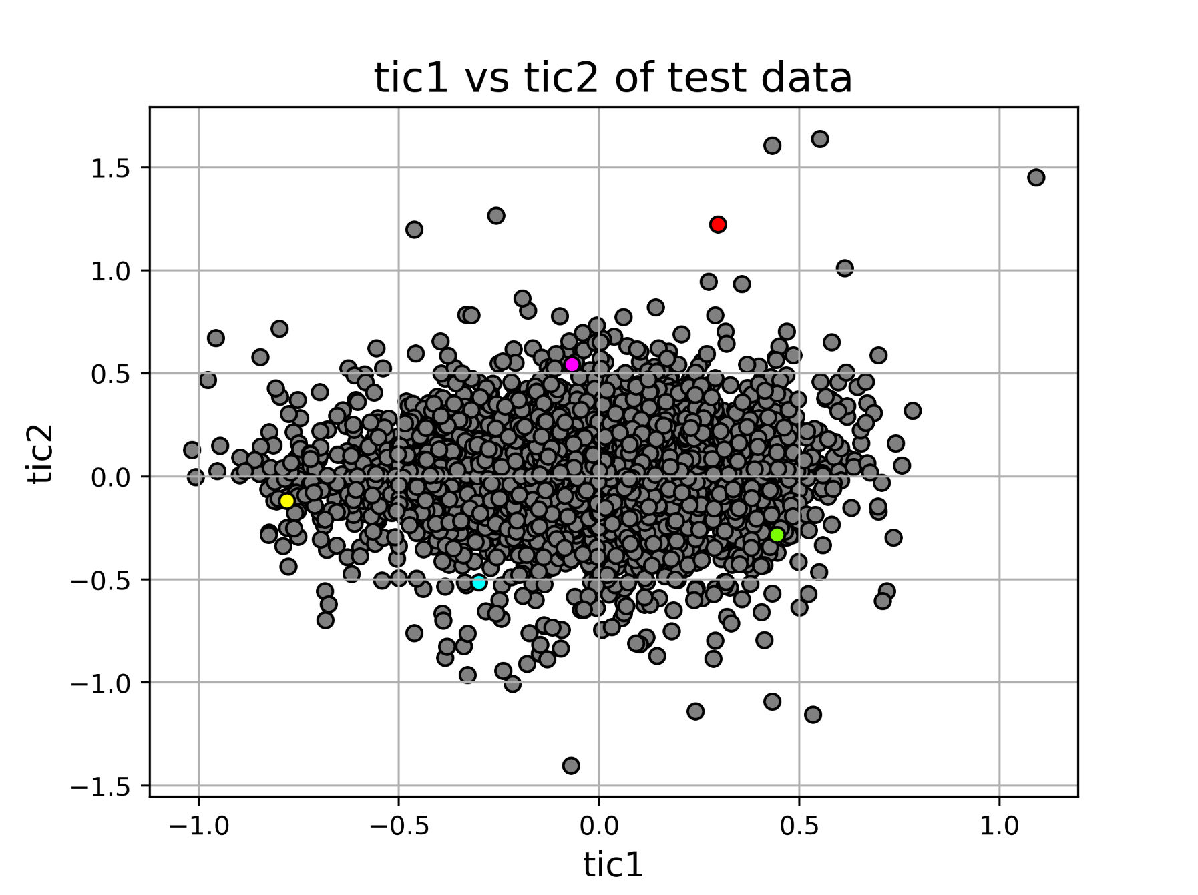
Chosen predictions vs back-mapped labels on tICs space

Slide 15
Modification of The Neural Network
Input Layer
First Hidden Layer
ReLU activation
Dropout
Optimizer - Adam (Adaptive Moment Estimation) with learning rate = 0.001
Second Hidden Layer
ReLU activation
Dropout
Custom MSE Loss – MSE of Coordinate + ( 2 x MSE of tICs)
Third Hidden Layer
ReLU activation
Dropout
Fourth Hidden Layer
ReLU activation
Dropout
Fifth Hidden Layer
Sigmoid activation
Output Layer

Slide 16
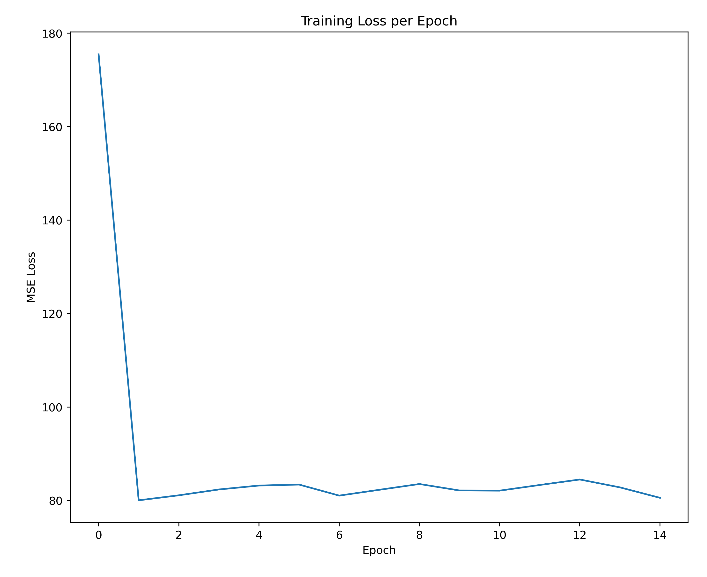
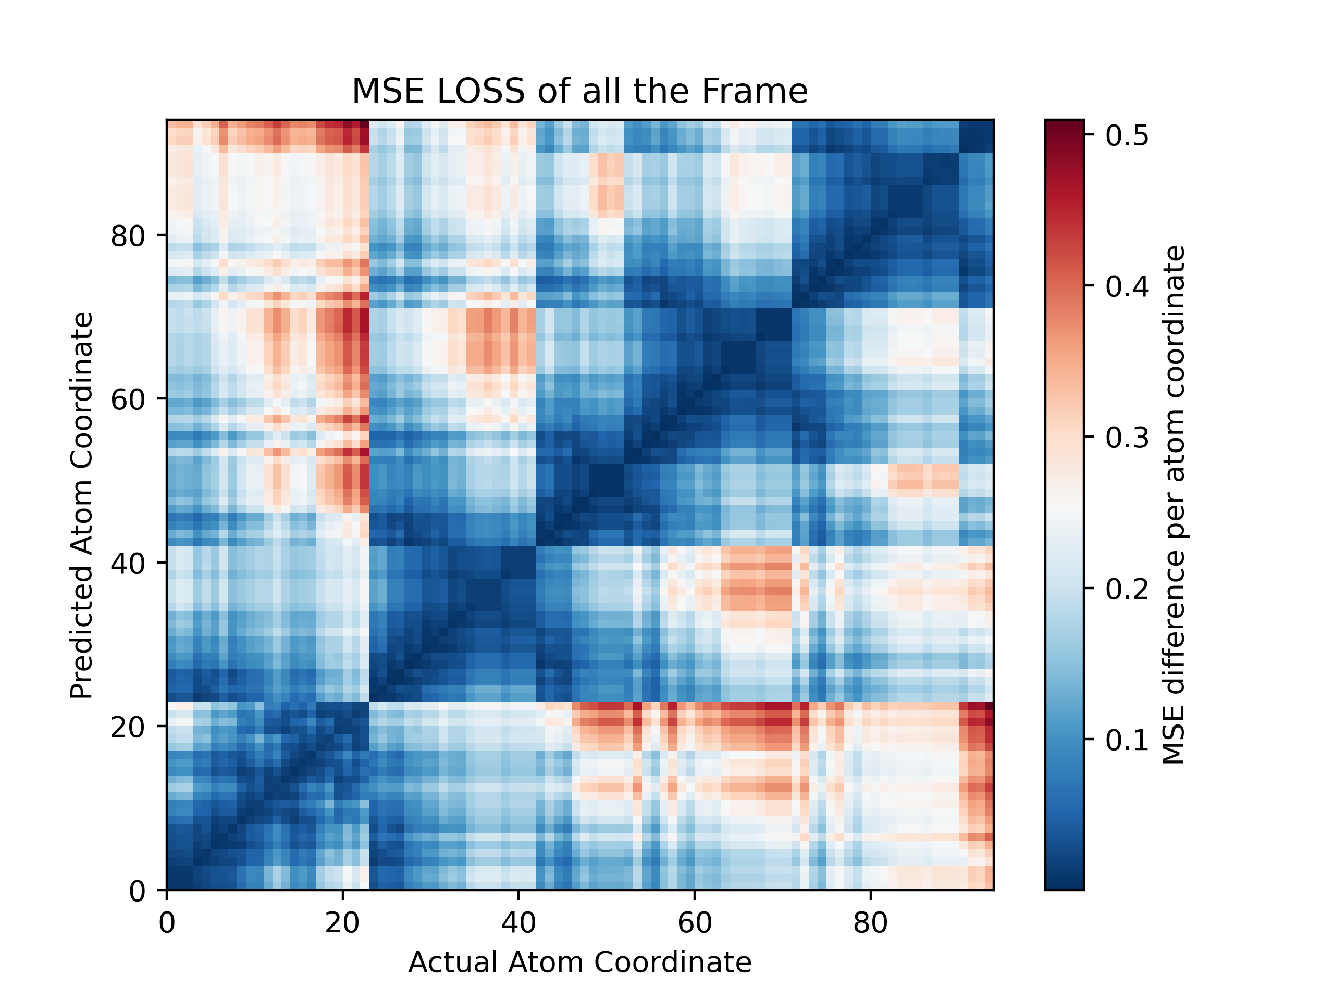
Outputs of Neural Network
MSE loss of each atoms coordinate for all the Validation frame
MSE loss of Training Data

Slide 17
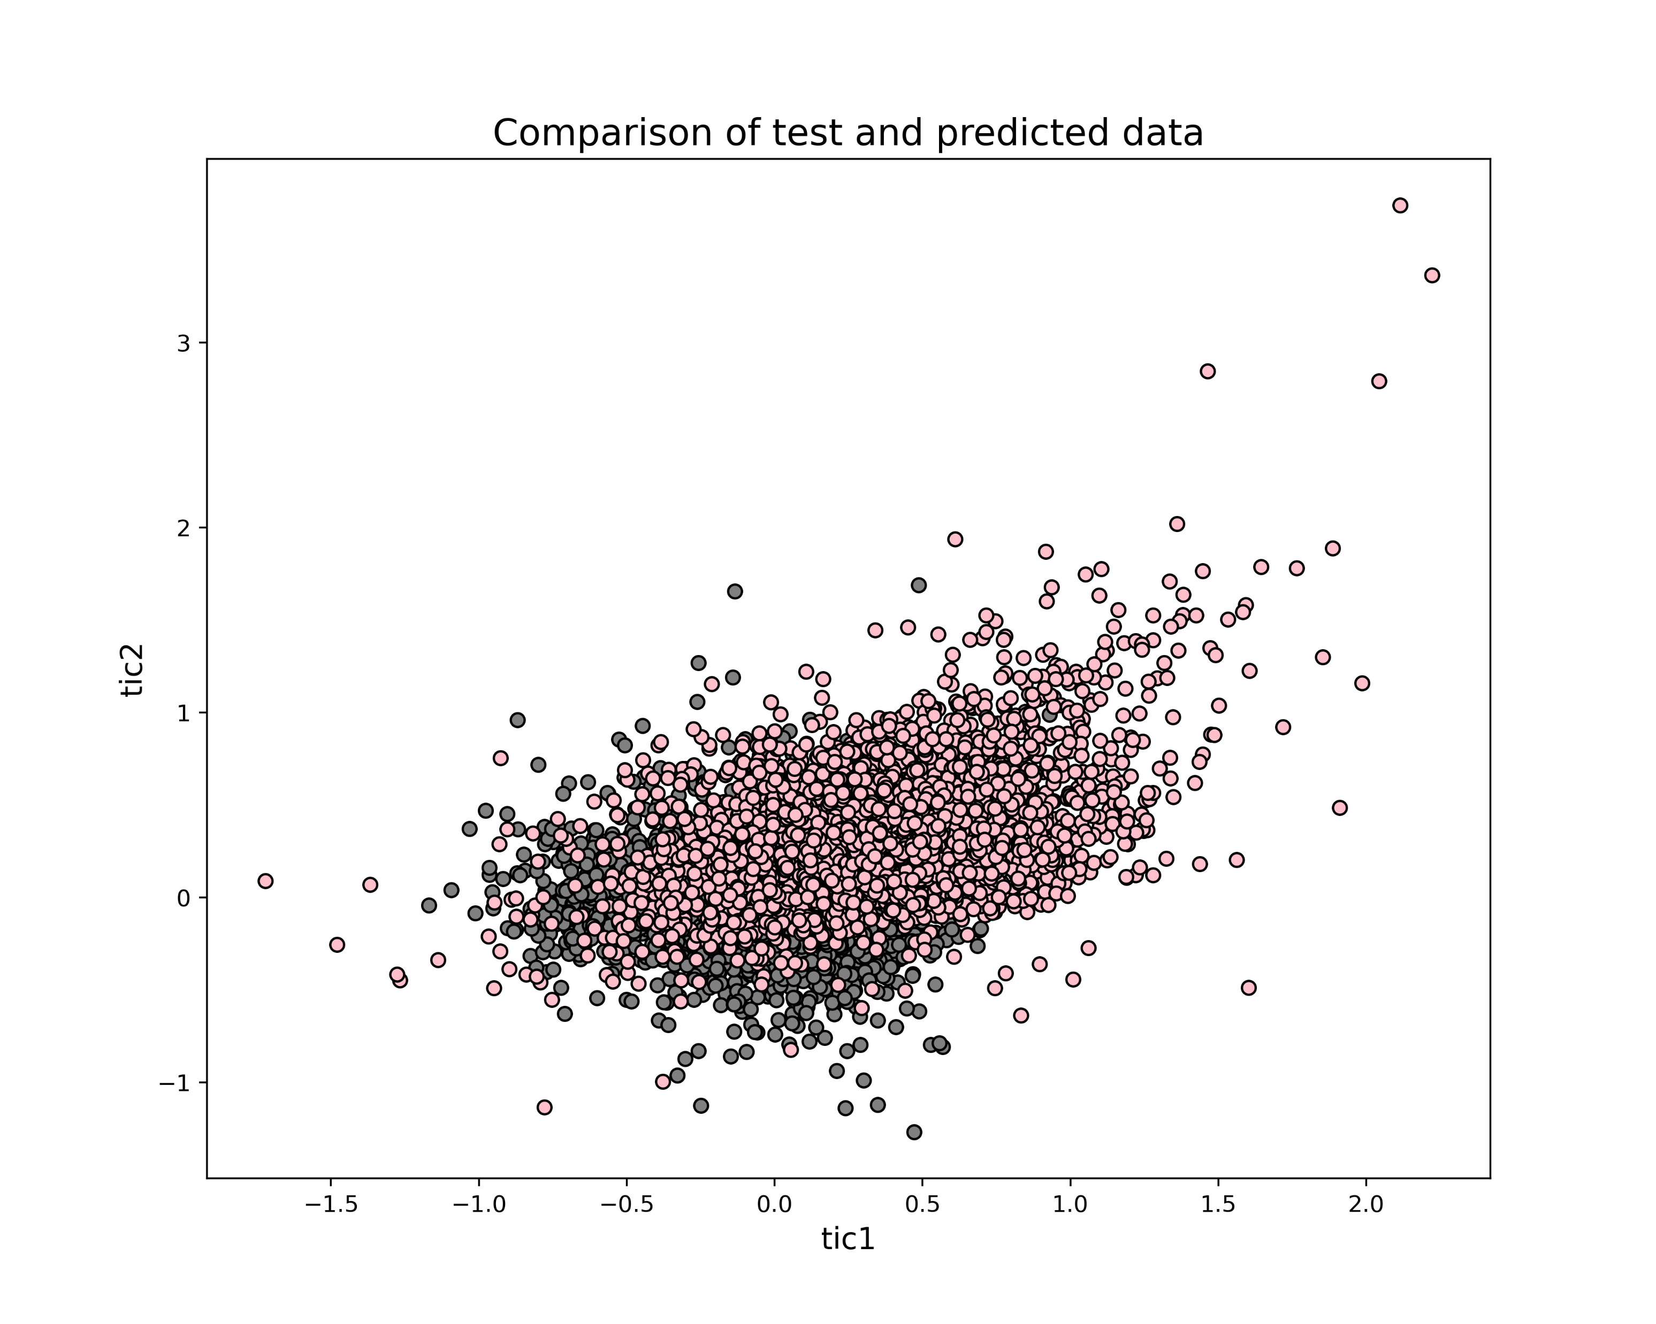
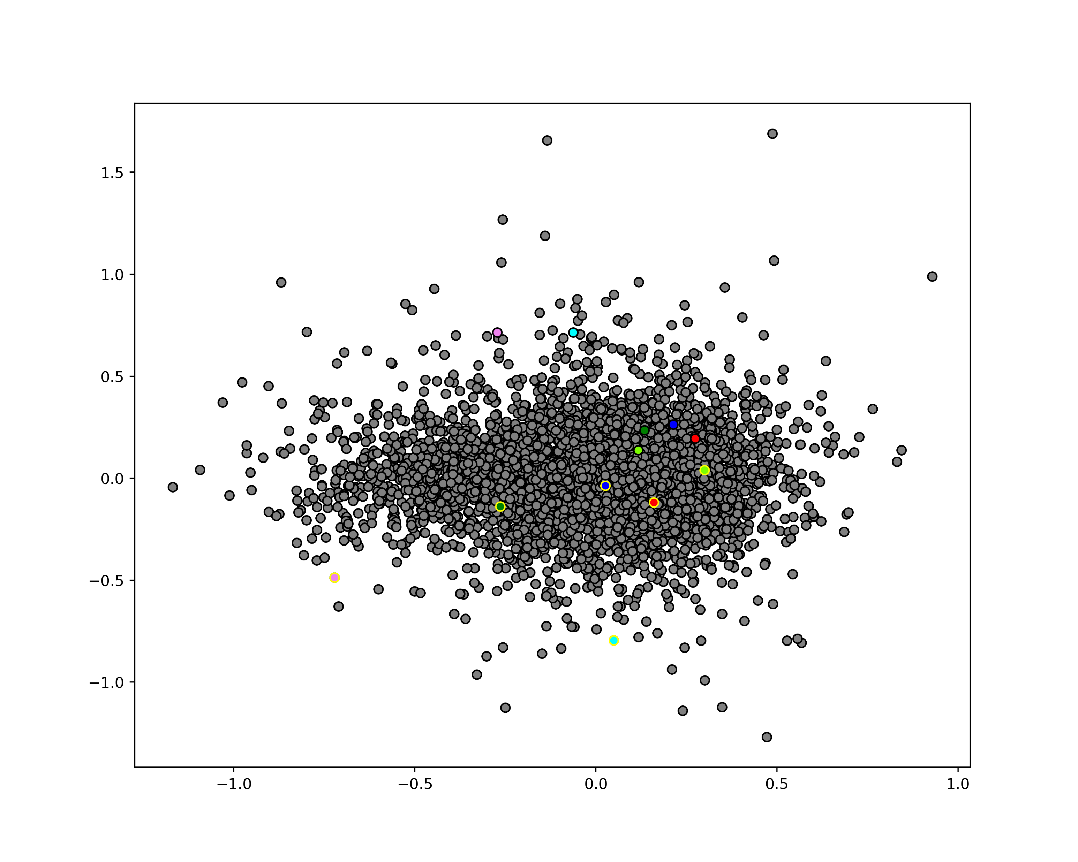
Chosen predictions vs back-mapped labels on tICs space
Chosen points and back mapped labels in tICs Space
Back-mapped labels
Prediction
tIC2
tIC1

Slide 18
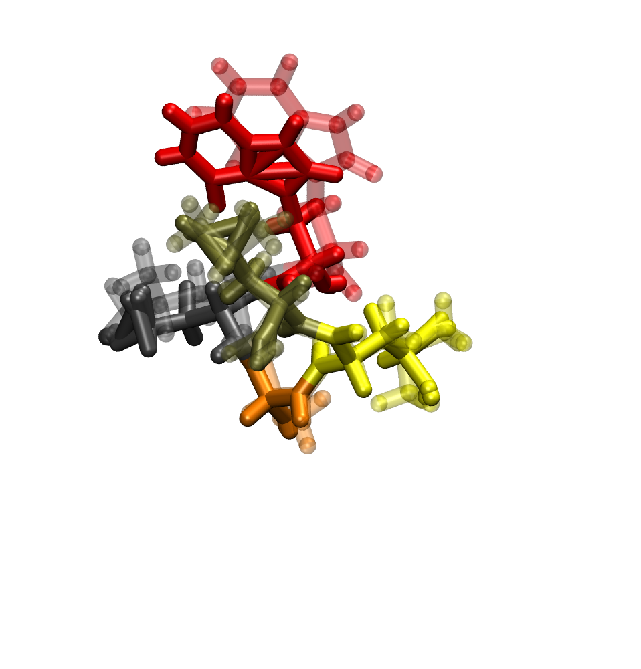
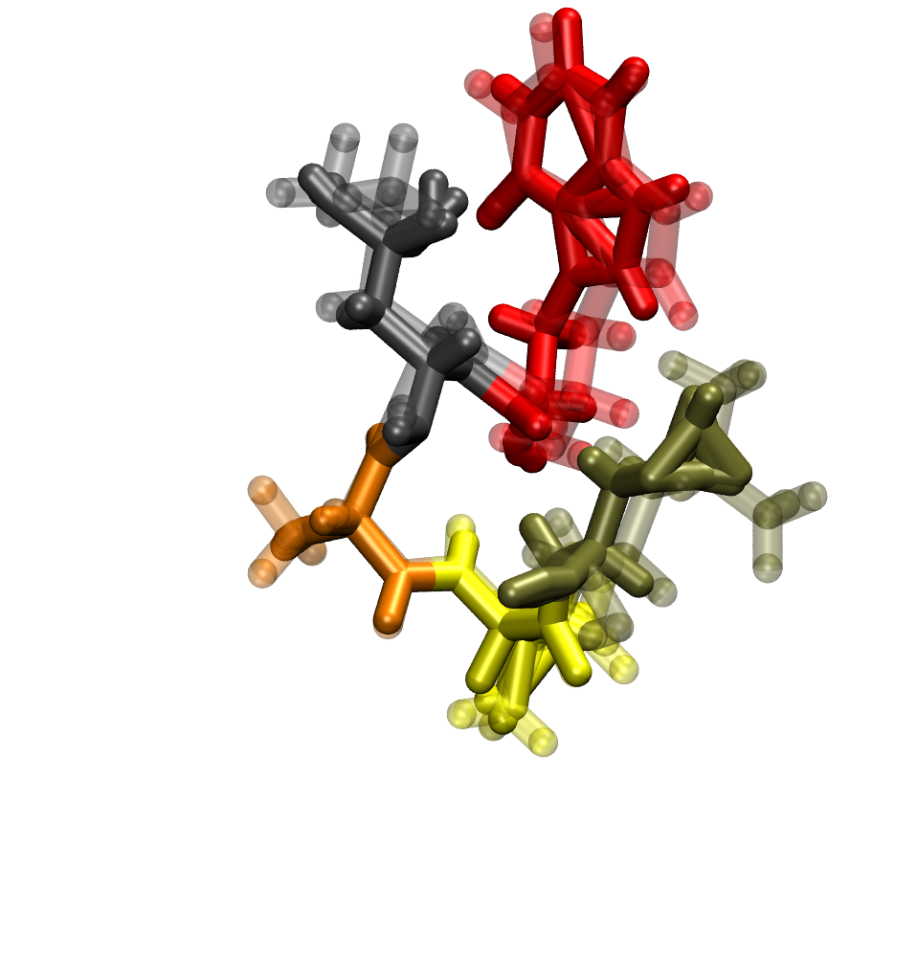
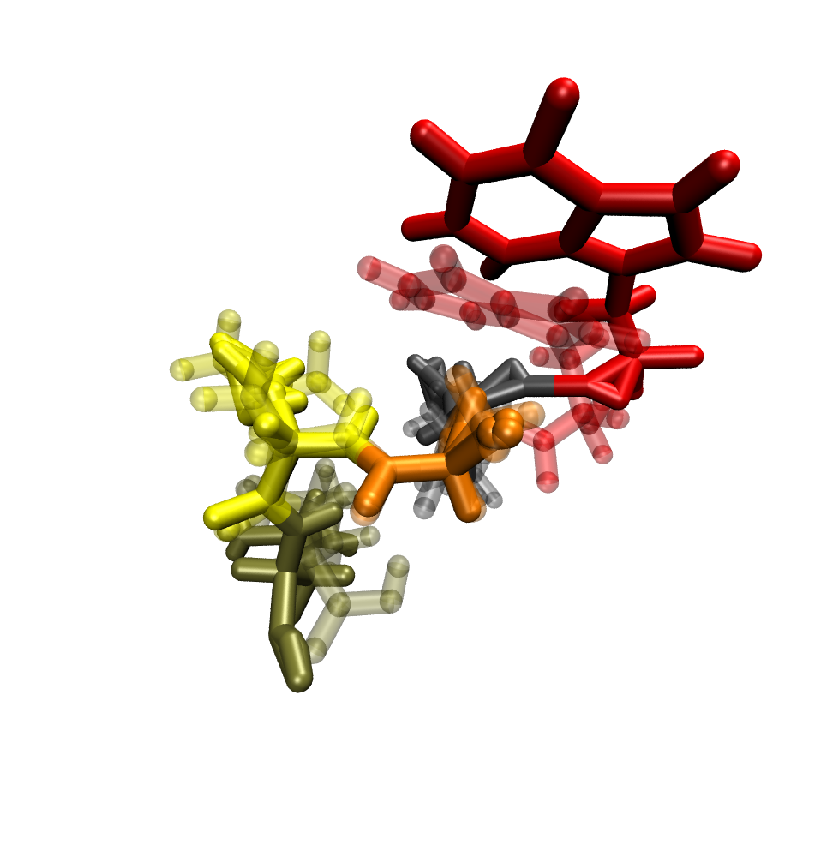
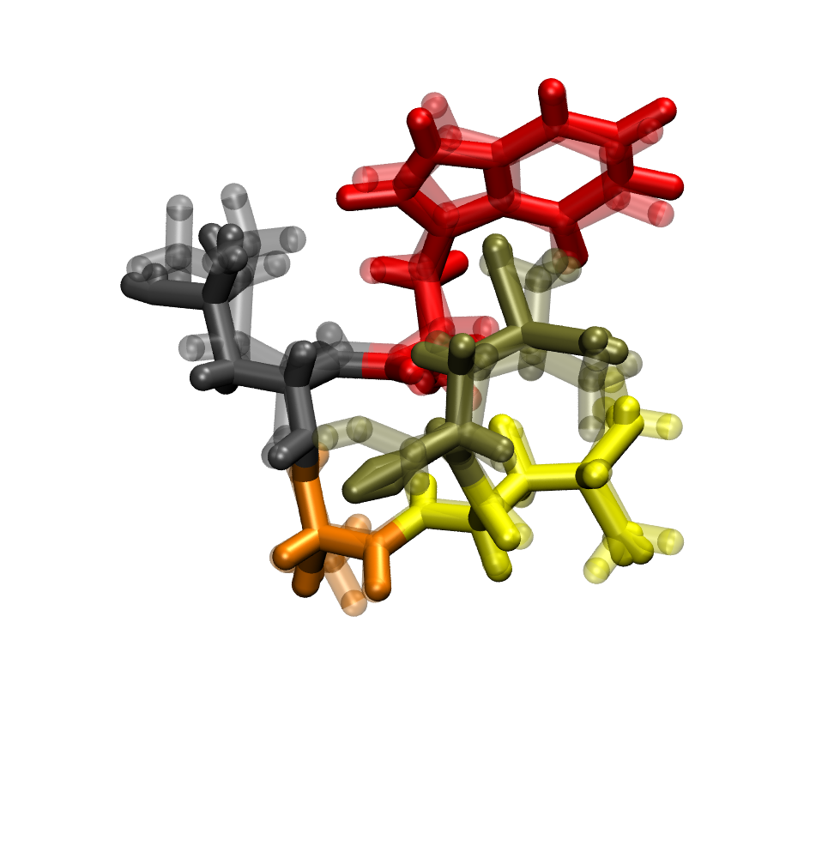
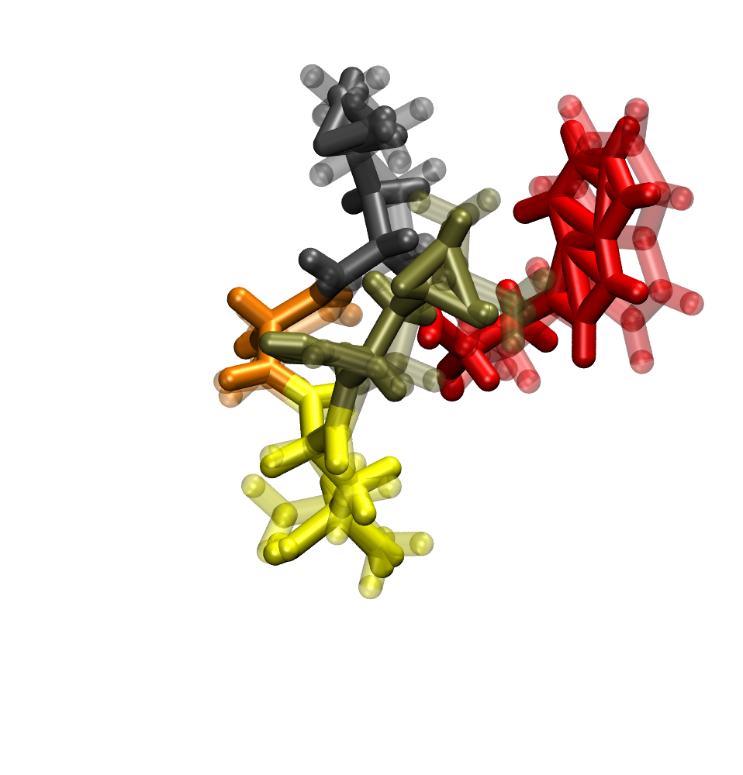
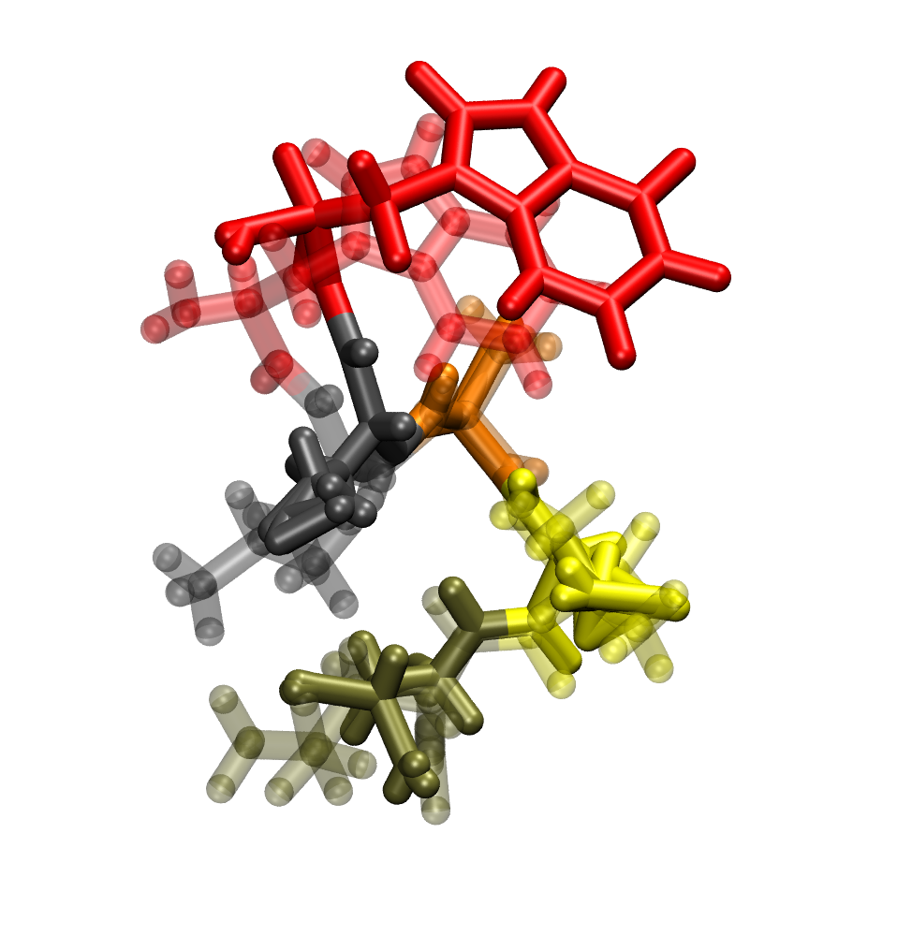
Predictions(solid) with labels (transparent) without minimization

Slide 19
Convolutional Neural Networks
Input Layer
Convolutional layer
kernel size -> (1,3)
Padding -> (0,1)
Convolutional Avg. Pool
kernel size -> (1,2)
First Convolutional Layer
ReLU activation
BatchNorm
AvgPool
Optimizer - Adam (Adaptive Moment Estimation) with learning rate = 0.001
Second Convolutional Layer
ReLU activation
BatchNorm
AvgPool
Custom MSE Loss – MSE of Coordinate + ( 2 x MSE of tICs)
Convolutional Output
Flatten
Fully Connected Input
First Hidden layer
Sigmoid Activation
Output Layer

Slide 20
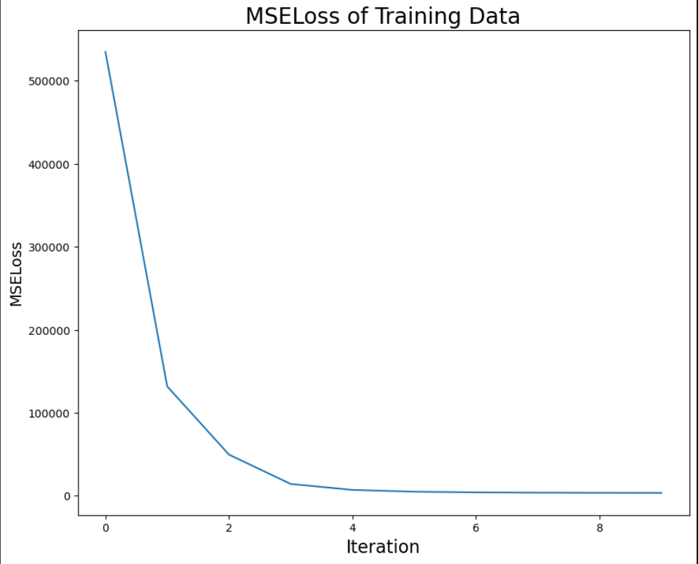
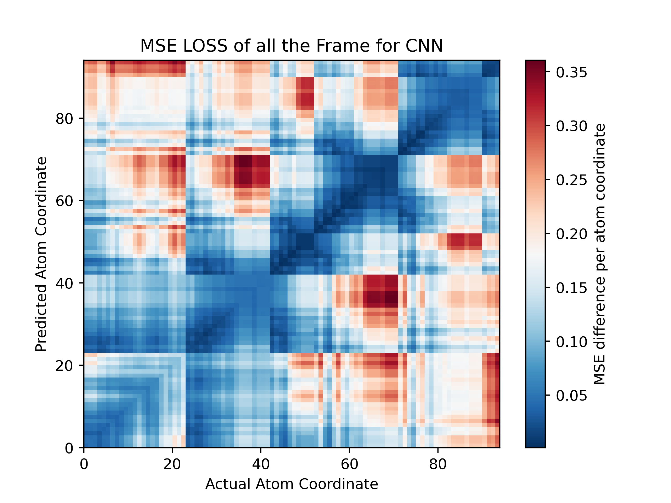
Outputs of CNN
MSE loss of Training Data

Slide 21
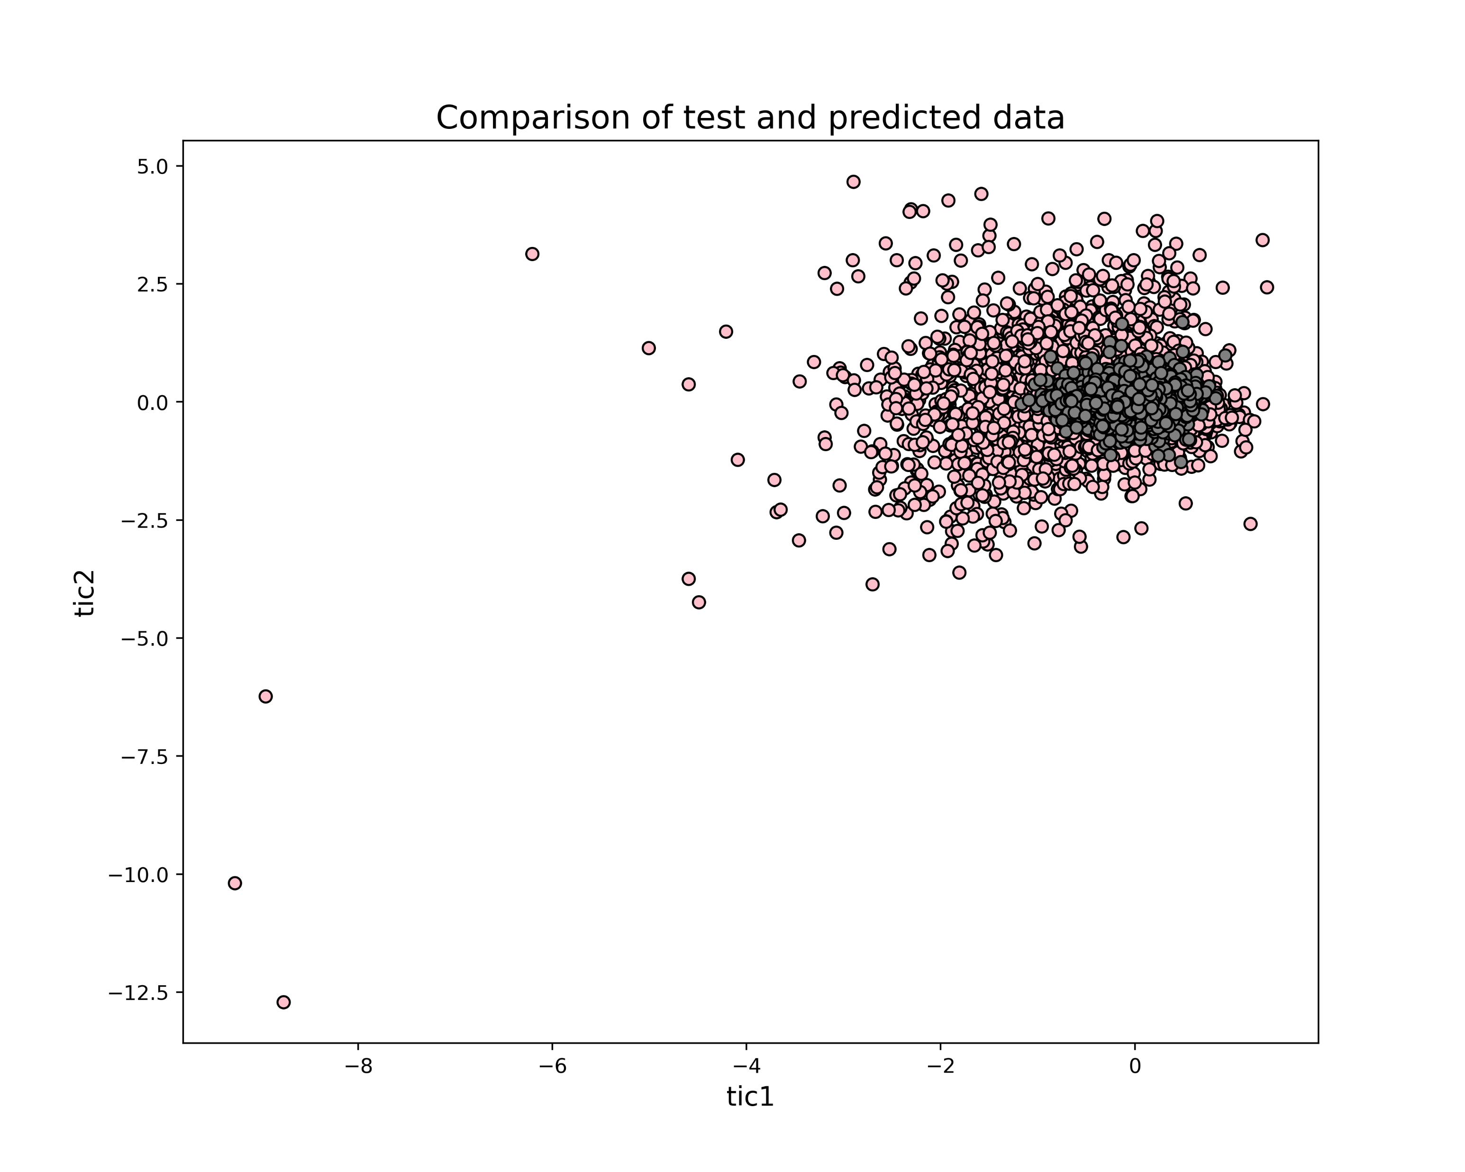
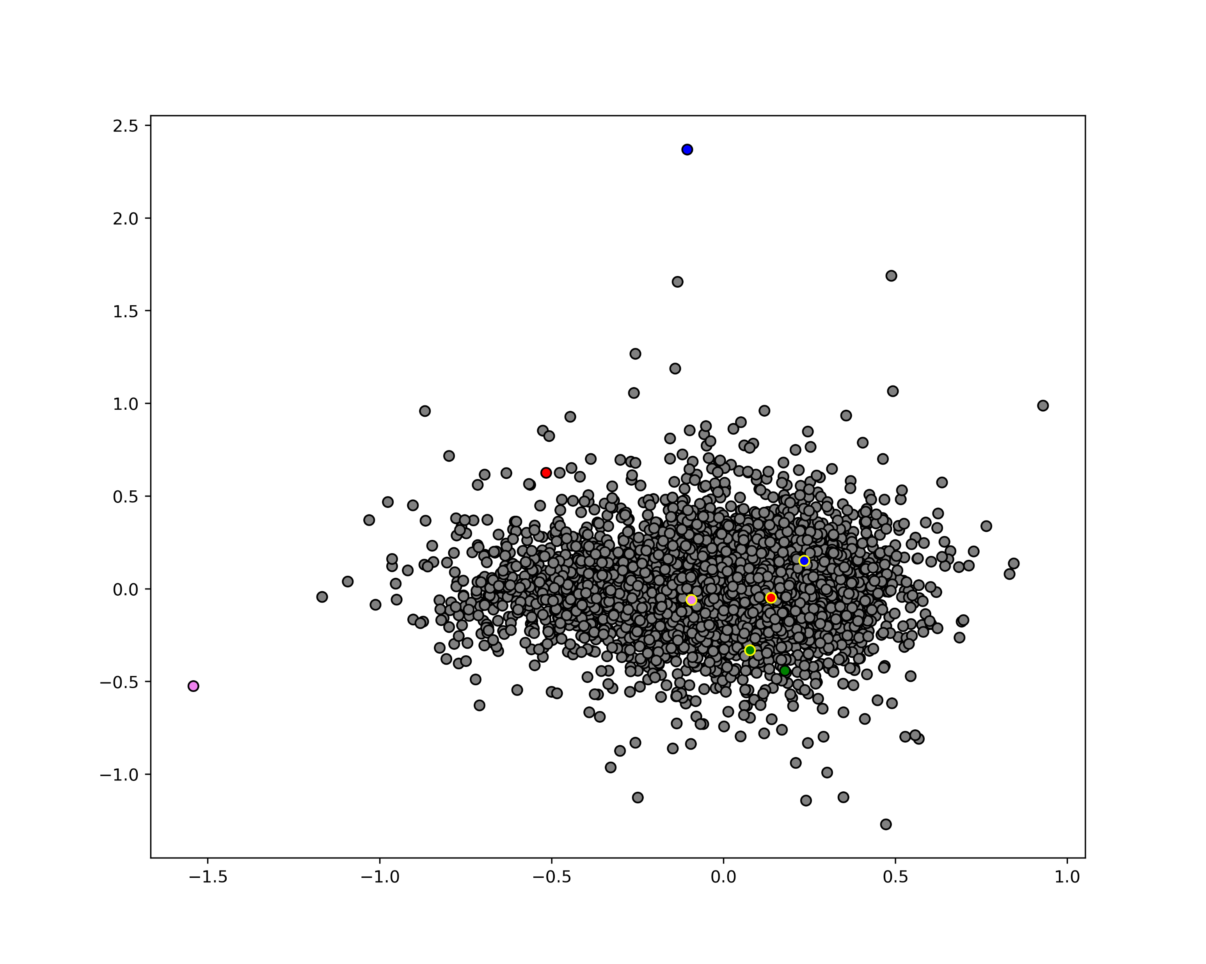
Chosen predictions vs back-mapped labels on tICs space in CNN
tIC2
Back-mapped labels
Prediction
tIC1

Slide 22
Future Work
The Neural Network can be modified with other features and more hidden layers.
A good System with a powerful GPU can reduce the time taken for training
Can try a Transformers Neural Network

Slide 23
THANK YOU

